Slide 1
Bootstrap Alert
廖向德

Slide 2
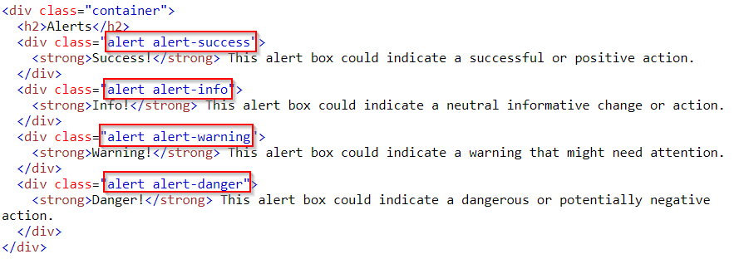
Alerts (1/2)
Alerts are created with the .alert class, followed by one of the four contextual classes .alert-success, .alert-info, .alert-warning or .alert-danger

Slide 3
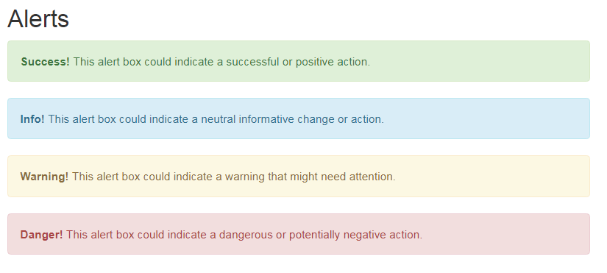
Alerts (2/2)
https://www.w3schools.com/bootstrap/tryit.asp?filename=trybs_alerts&stacked=h

Slide 4
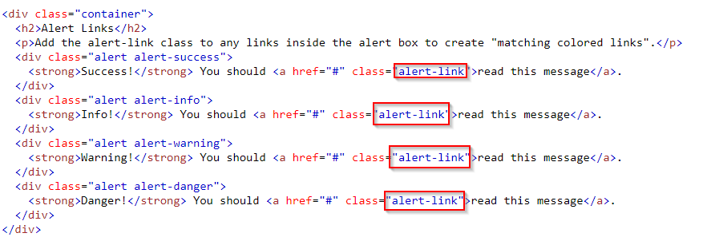
Alert Links (1/2)
Add the .alert-link class to any links inside the alert box to create "matching colored links"
Notes:
<!DOCTYPE html>
<html lang="en">
<head>
<title>Bootstrap Example</title>
<meta charset="utf-8">
<meta name="viewport" content="width=device-width, initial-scale=1">
<link rel="stylesheet" href="https://maxcdn.bootstrapcdn.com/bootstrap/3.3.7/css/bootstrap.min.css">
<script src="https://ajax.googleapis.com/ajax/libs/jquery/3.2.1/jquery.min.js"></script>
<script src="https://maxcdn.bootstrapcdn.com/bootstrap/3.3.7/js/bootstrap.min.js"></script>
</head>
<body>
<div class="container">
<h2>Alert Links</h2>
<p>Add the alert-link class to any links inside the alert box to create "matching colored links".</p>
<div class="alert alert-success">
<strong>Success!</strong> You should <a href="#" class="alert-link">read this message</a>.
</div>
<div class="alert alert-info">
<strong>Info!</strong> You should <a href="#" class="alert-link">read this message</a>.
</div>
<div class="alert alert-warning">
<strong>Warning!</strong> You should <a href="#" class="alert-link">read this message</a>.
</div>
<div class="alert alert-danger">
<strong>Danger!</strong> You should <a href="#" class="alert-link">read this message</a>.
</div>
</div>
</body>
</html>

Slide 5
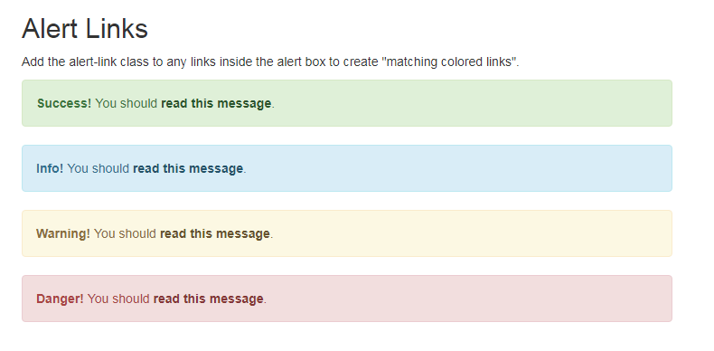
Alert Links (2/2)
https://www.w3schools.com/bootstrap/tryit.asp?filename=trybs_alerts_link&stacked=h

Slide 6
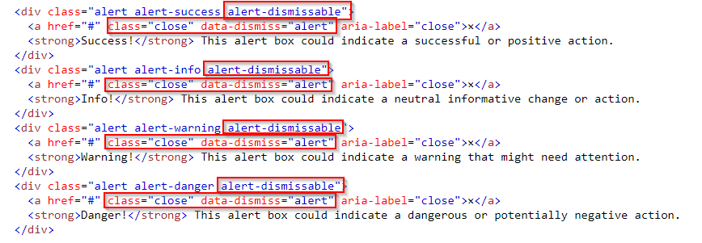
Closing Alerts (1/2)
To close the alert message, add a .alert-dismissable class to the alert container. Then add class="close" and data-dismiss="alert" to a link or a button element (when you click on this the alert box will disappear).
Notes:
<!DOCTYPE html>
<html lang="en">
<head>
<title>Bootstrap Example</title>
<meta charset="utf-8">
<meta name="viewport" content="width=device-width, initial-scale=1">
<link rel="stylesheet" href="https://maxcdn.bootstrapcdn.com/bootstrap/3.3.7/css/bootstrap.min.css">
<script src="https://ajax.googleapis.com/ajax/libs/jquery/3.2.1/jquery.min.js"></script>
<script src="https://maxcdn.bootstrapcdn.com/bootstrap/3.3.7/js/bootstrap.min.js"></script>
</head>
<body>
<div class="container">
<h2>Alerts</h2>
<p>The a element with class="close" and data-dismiss="alert" is used to close the alert box.</p>
<p>The alert-dismissible class adds some extra padding to the close button.</p>
<div class="alert alert-success alert-dismissable">
<a href="#" class="close" data-dismiss="alert" aria-label="close">×</a>
<strong>Success!</strong> This alert box could indicate a successful or positive action.
</div>
<div class="alert alert-info alert-dismissable">
<a href="#" class="close" data-dismiss="alert" aria-label="close">×</a>
<strong>Info!</strong> This alert box could indicate a neutral informative change or action.
</div>
<div class="alert alert-warning alert-dismissable">
<a href="#" class="close" data-dismiss="alert" aria-label="close">×</a>
<strong>Warning!</strong> This alert box could indicate a warning that might need attention.
</div>
<div class="alert alert-danger alert-dismissable">
<a href="#" class="close" data-dismiss="alert" aria-label="close">×</a>
<strong>Danger!</strong> This alert box could indicate a dangerous or potentially negative action.
</div>
</div>
</body>
</html>

Slide 7
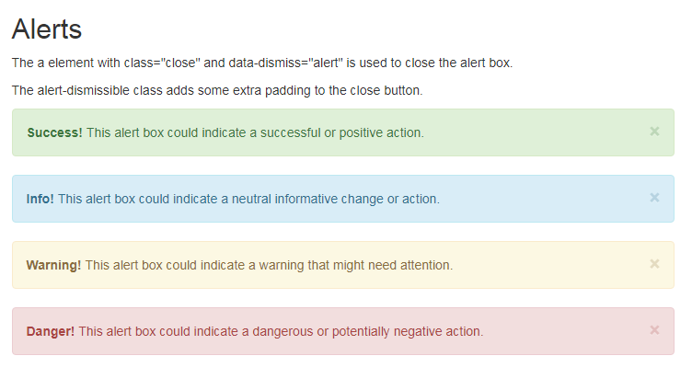
Closing Alerts (2/2)
https://www.w3schools.com/bootstrap/tryit.asp?filename=trybs_alerts_dismissible&stacked=h

Slide 8

Animated Alerts
The .fade and .in classes adds a fading effect when closing the alert message
https://www.w3schools.com/bootstrap/tryit.asp?filename=trybs_alerts_fade&stacked=h
Notes:
<!DOCTYPE html>
<html lang="en">
<head>
<title>Bootstrap Example</title>
<meta charset="utf-8">
<meta name="viewport" content="width=device-width, initial-scale=1">
<link rel="stylesheet" href="https://maxcdn.bootstrapcdn.com/bootstrap/3.3.7/css/bootstrap.min.css">
<script src="https://ajax.googleapis.com/ajax/libs/jquery/3.2.1/jquery.min.js"></script>
<script src="https://maxcdn.bootstrapcdn.com/bootstrap/3.3.7/js/bootstrap.min.js"></script>
</head>
<body>
<div class="container">
<h2>Animated Alerts</h2>
<p>The .fade and .in classes adds a fading effect when closing the alert message.</p>
<div class="alert alert-success fade in">
<a href="#" class="close" data-dismiss="alert" aria-label="close">&times;</a>
<strong>Success!</strong> This alert box could indicate a successful or positive action.
</div>
<div class="alert alert-info alert-dismissable fade in">
<a href="#" class="close" data-dismiss="alert" aria-label="close">&times;</a>
<strong>Info!</strong> This alert box could indicate a neutral informative change or action.
</div>
<div class="alert alert-warning alert-dismissable fade in">
<a href="#" class="close" data-dismiss="alert" aria-label="close">&times;</a>
<strong>Warning!</strong> This alert box could indicate a warning that might need attention.
</div>
<div class="alert alert-danger alert-dismissable fade in">
<a href="#" class="close" data-dismiss="alert" aria-label="close">&times;</a>
<strong>Danger!</strong> This alert box could indicate a dangerous or potentially negative action.
</div>
</div>
</body>
</html>

